Slide 1
Assignment Questions on Digital Marketing

Slide 2
1. Create a blog or website using Blogspot and WordPress.
Customize the theme design and post new article with 500
words.
2. Create a New Facebook Business Page and post one
social media poster for your brand.
3. Create and design a social media advertisement poster
using canva.
4. Create email newsletter design using MailChimp or canva

Slide 3
1.Blog website URL: https://www.blogger.com/blog/posts/6030222005429878173

Slide 4
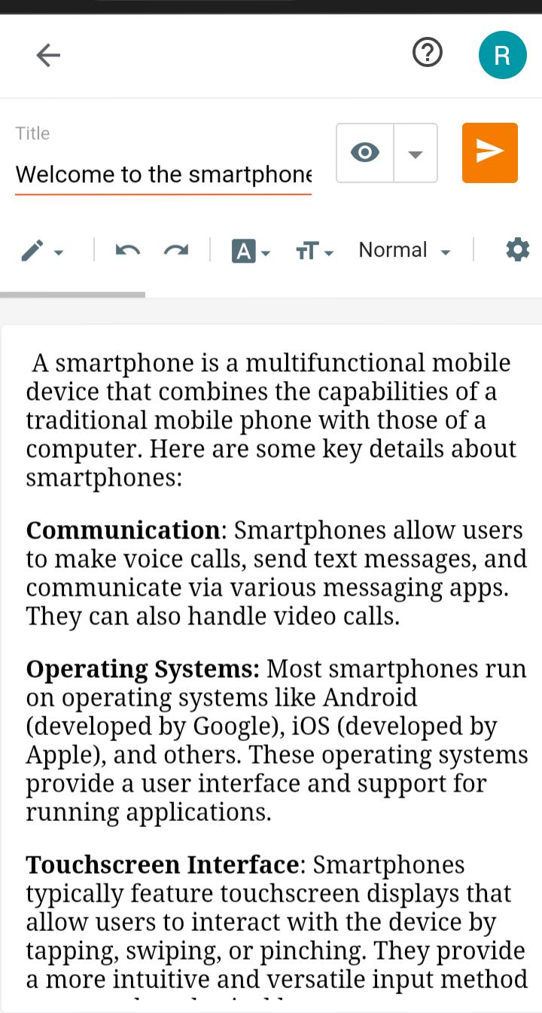

Slide 5
2.
Brand Name: Sugar Buzz
Category: Sweets
Target Audience: All (Men, Women and Kids)
Email : sugarbuzz45@gmail.com
Facebook Business Page :https://www.facebook.com/profile.php?id=61552145057281&mibextid=ZbWKwL

Slide 6
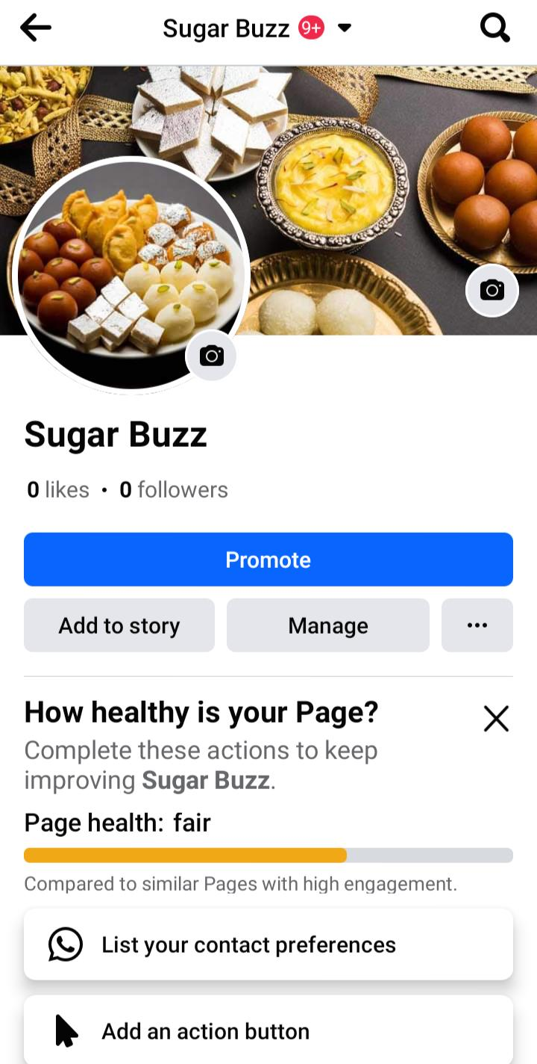

Slide 7
3.
Brand Name: Sugar Buzz Category: Sweets Target Audience: All (Men, Women and Kids) Email : sugarbuzz45@gmail.com Facebook Business Page: https://www.facebook.com/profile.php?id=61552145057281&mibextid=ZbWKwL

Slide 8
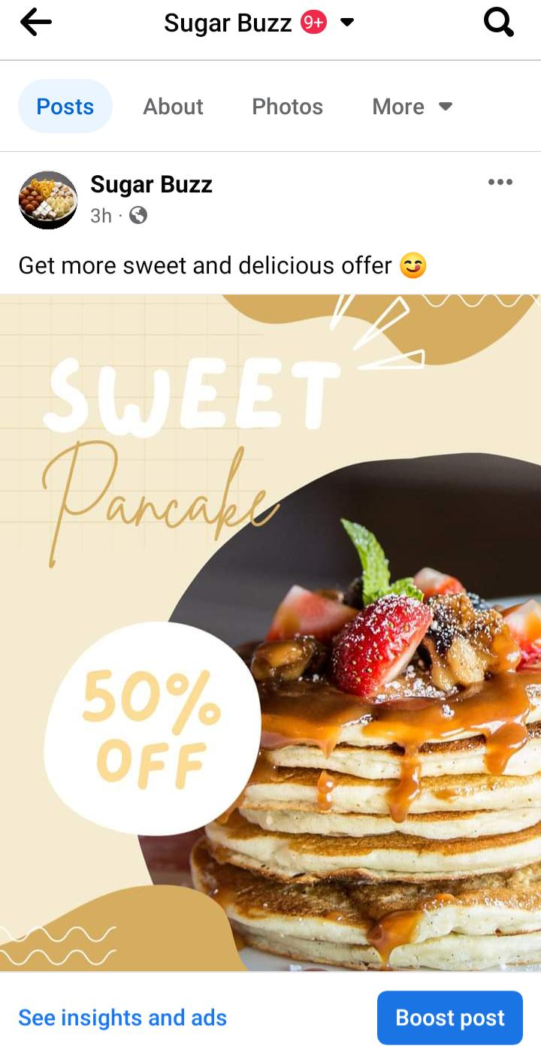

Slide 9
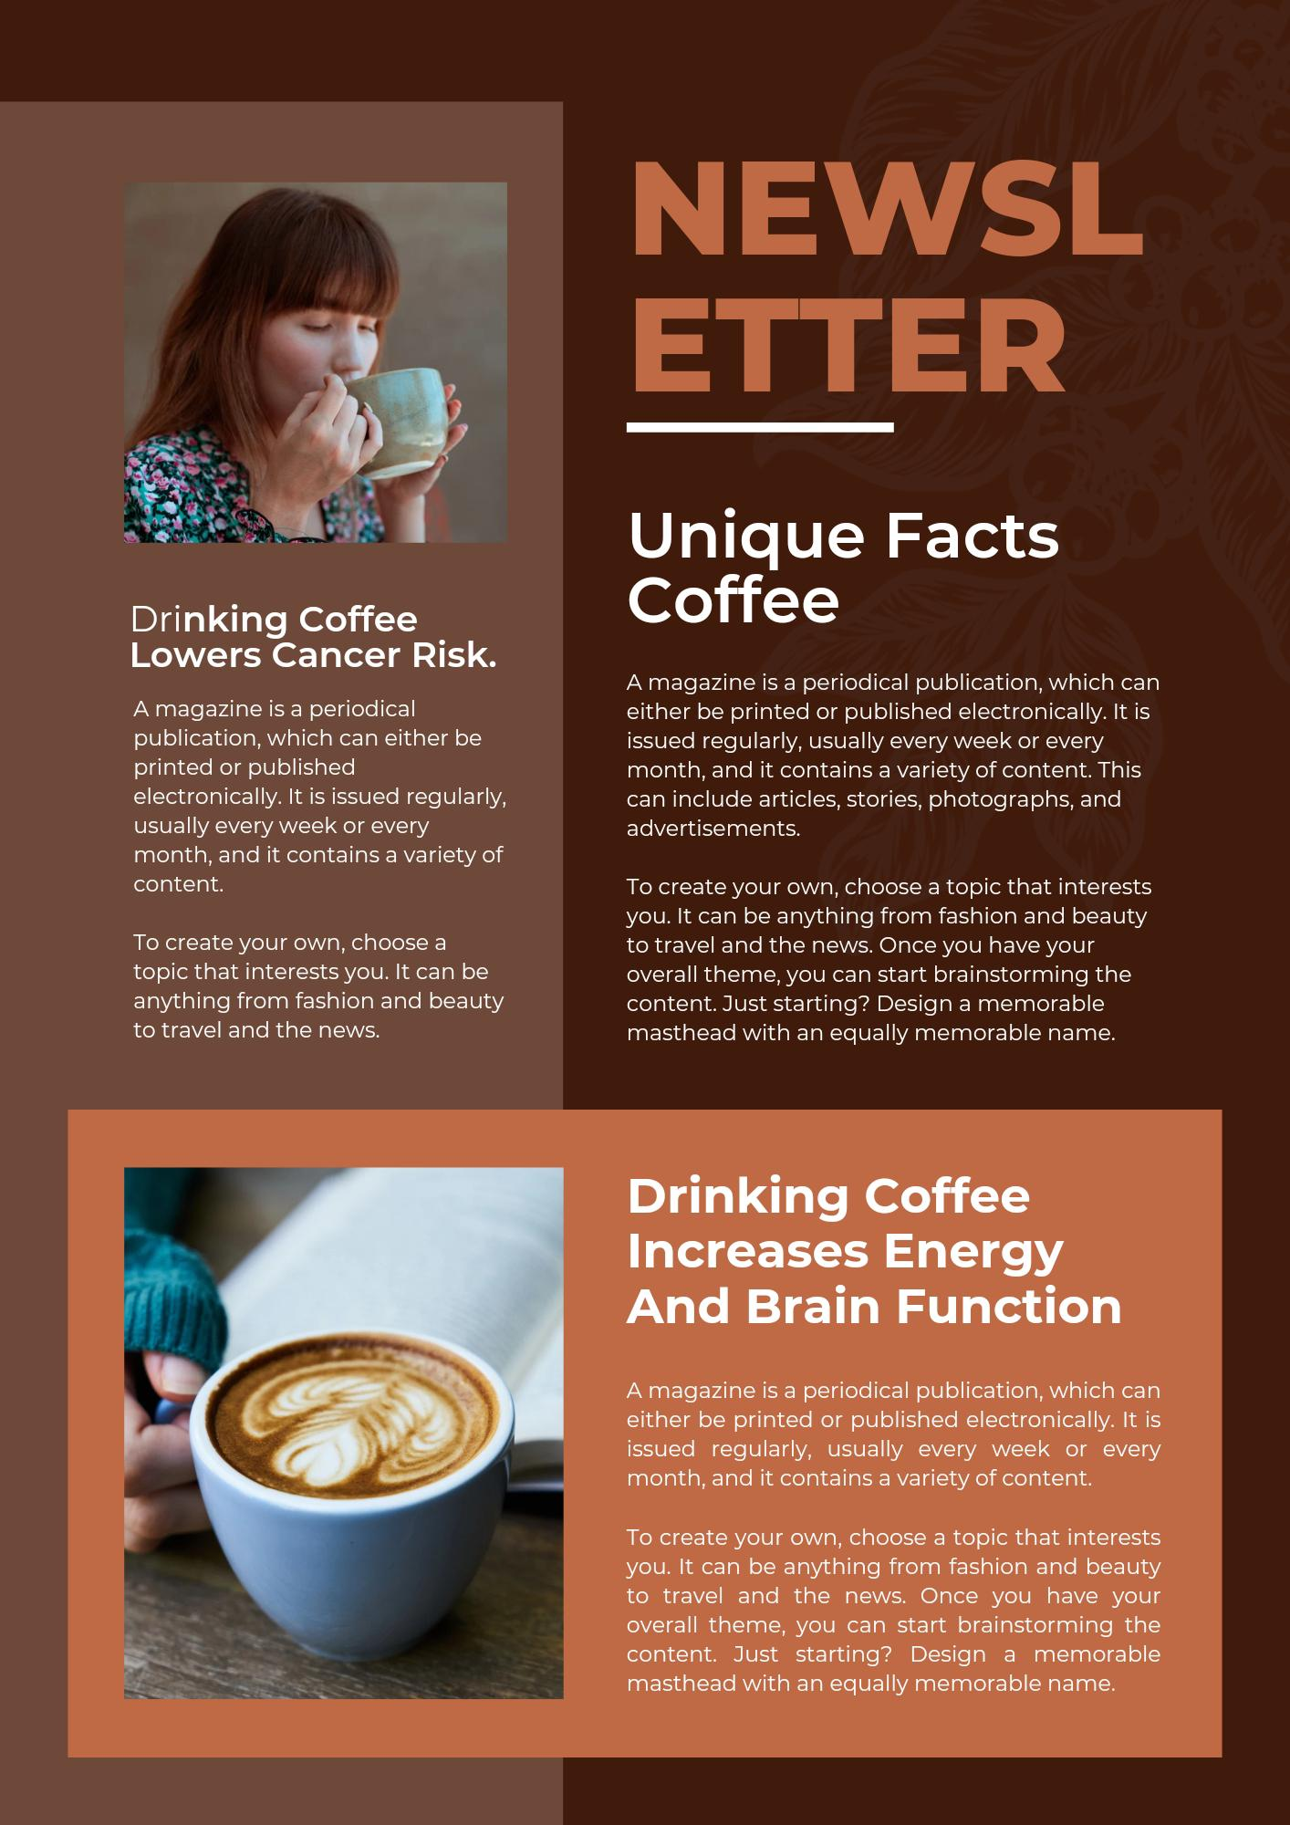
4.

